Slide 1

Production Plant Layout (1)
Facility Layout Problem: design problem
  locations of activities
  dimensions
  configurations
No overall algorithm exists

Slide 2
Production Plant Layout (2)
Production Plant Layout (2)
Design problem
Greenfield
Location of one new machine
Reasons:
  new products
  changes in demand
  changes in product design
  new machines
  bottlenecks
  too large buffers
  too long transfer times

Slide 3
Design
Product
Layout
Logistics
Process

Slide 4
Production Plant Layout (3)
Goals (examples):
  minimal material handling costs
  minimal investments
  minimal throughput time
  flexibility
  efficient use of space

Slide 5
Production Plant Layout (4)
Restrictions:
  legislation on employees working conditions
  present building (columns/waterworks)
Methods:
  Immer: The right equipment at the right place to permit effective processing
  Apple: Short distances and short times

Slide 6
Goals Production Plant Layout
Plan for the preferred situation in the future
Layout must support objectives of the facility
No accurate data → layout must be flexible

Slide 7
Systematic Layout Planning
Muther (1961)
0 Data gathering
1 Flow
2 Activities
Analysis
3 Relationship
diagram
4 Space requirements
5 Space available
6 Space relationship
diagram
Search
7 Reasons to modify
8 Restrictions
9 Layout alternatives
Selection
10 Evaluation

Slide 8
0 - Data gathering (1)
Source: product design
  BOM
  drawings
  “gozinto” (assembly) chart, see fig 2.10
  redesign, standardization → simplifications
product design
sequence of assembly operations
machines
layout (assembly) line

Slide 9
0 - Data gathering (2)
Source: Process design
  make/buy
  equipment used
  process times
operations process chart (fig 2.12)
assembly chart
operations
precedence diagram
(fig 2.13)

Slide 10
0 - Data gathering (3)
Source: Production schedule design
  logistics: where to produce, how much → product mix
  marketing: demand forecast →
  production rate
  types and number of machines
  continuous/intermittent
  layout ←→ schedule

Slide 11
1/2 - Flow and Activity Analysis
Flow analysis:
  Types of flow patterns
  Types of layout
→ flow analysis approaches
Activity relationship analysis

Slide 12
1/2 - Flow analysis and activity analysis
Flow analysis
quantitative measure of movements between departments:
material handling costs
Activity analysis
qualitative factors

Slide 13
Flow analysis
Flow of materials, equipment and personnel
Raw material
Finished product
layout facilitates this flow

Slide 14
Types of flow patterns
Horizontal transport
R
S
R
S
  P = receiving
  S = shipping
S
long line
R

Slide 15
Layout
volumes of production
variety of products
volumes: what is the right measure of volume from a layout perspective?
variety → high/low commonality
layout type

Slide 16
Types of layout
Fixed product layout
Product layout
Group layout
Process layout

Slide 17
Fixed product layout
Processes → product (e.g. shipbuilding)

Slide 18
Product layout (flow shop)
Production line according to the processing sequence of the product
High volume production
Short distances

Slide 19
Process layout (Job shop)
All machines performing a particular process are grouped together in a processing department
Low production volumes
Rapid changes in the product mix
High interdepartmental flow

Slide 20
Group layout
Compromise between product layout and process layout
Product layouts for product families → cells (cellular layout)
Group technology

Slide 21
Production volume and product variety determines type of layout
production volume
product layout
group layout
process layout
product variety

Slide 22
Layout determines
material handling
utilization of space, equipment and personnel (table 2.2)
Flow analysis techniques
Flow process charts ←→ product layout
From-to-chart ←→ process layouts

Slide 23
Activity relationship analysis
Relationship chart (figure 2.24)
Qualitative factors (subjective!)
Closeness rating (A, E, I, O, U or X)

Slide 24
3 - Relationship diagrams
Construction of relationships diagrams: diagramming
Methods, amongst others: CORELAP

Slide 25
Relationship diagram (1)
Spatial picture of the relationships between departments
Constructing a relation diagram often requires compromises.
What is closeness? 10 or 50 meters?
See figure 2.25

Slide 26
Relationship diagram (2)
Premise: geographic proximity reflects the
relationships
Sometimes other solutions:
  e.g. X-rating because of noise → acoustical panels instead of distance separation
  e.g. A rating because of communication requirement →
  computer network instead of proximity

Slide 27
Graph theory based approach
close ←→ adjacent
department-node
adjacent-edge
requirement: graph is planar
(no intersections)
region-face
adjacent faces: share a common edge
graph

Slide 28
Primal graph → dual graph
Place a node in each face
Two faces which share an edge – join the dual nodes by an edge
Faces dual graph correspond to the departments in primal graph →
block layout (plan) e.g. figure 2.39

Slide 29
Graph theory
Primal graph planar → dual graph planar
Limitations to the use of graph theory:
it may be an aid to the layout designer

Slide 30
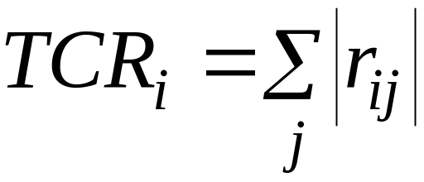
CORELAP
Construction “algorithm”
Adjacency!
Total closeness rating = sum of absolute values for the relationships with a particular department.

Slide 31
CORELAP - steps
sequence of placements of departments
location of departments

Slide 32
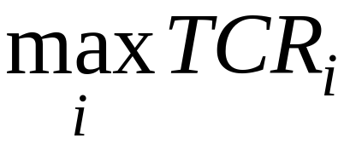
CORELAP – step 1
First department:
Second department:
  X-relation → “last placed department”
  A-relation with first. If none→ E-relation with first, etcetera

Slide 33
CORELAP – step 2
Weighted placement value
8
7
6
1
1st
5
2nd
2
3
4

Slide 34
4 - Space requirements
Building geometry or building site → space available
Desired production rate, distinguish:
  Engineer to order (ETO)
  Production to order (PTO)
  Production to stock (PTS)
  marketing forecast → productions quantities

Slide 35
4 - Space requirements
Equipment requirements:
Production rate → number of machines required
Employee requirements
rate
machines
employees
machine operators
assembly

Slide 36
Space determination
Methods:
  1. Production center
  2. Converting
  4. Standards
  5. Projection

Slide 37
4 - Space determination (1)
# machines per operator
Space requirements
# assembly operators
  1. Production center
    for manufacturing areas
    machine→space requirements
  2. Converting
    e.g. for storage areas
    present space requirement → space requirements
    non-linear function of production quantitiy

Slide 38
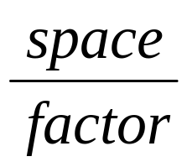
4 - Space determination (2)
Space standards
  standards
Ratio trend and projection
  e.g. direct labour hour, unit produced
  Not accurate!
  Include space for:
  packaging, storage, maintenance, offices, aisles, inspection, receiving and shipping, canteen, tool rooms, lavatories, offices, parking

Slide 39
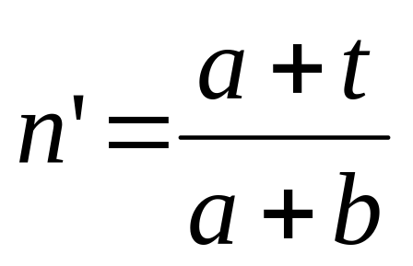
Deterministic approach (1)
n’ = # machines per operator (non-integer)
a = concurrent activity time
t = machine activity time
b= operator

Slide 40
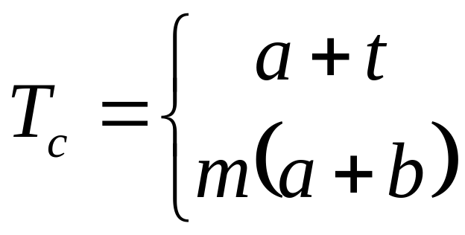
Deterministic approach (2)
T_{c} = cycle time
a = concurrent activity time
t = machine activity time
b = operator activity time
m = # machines per operator

Slide 41
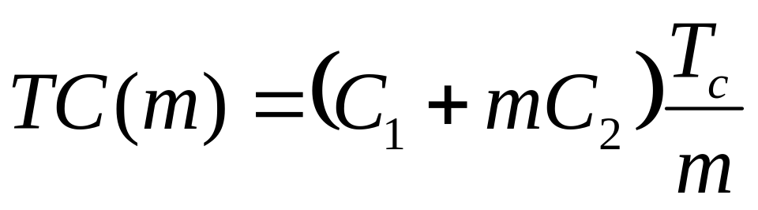
Deterministic approach (3)
TC(m) = cost per unit produced as a function of m
C₁ = cost per operator-hour
C₂ = cost per machine-hour
Compare TC(n) and TC(n+1) for n < n’ < n+1

Slide 42
Designing the layout (1)
Search phase
Alternative layouts
Design process includes
  Space relationship diagram
  Block plan
  Detailed layout
  Flexible layouts
  Material handling system
  Presentation

Slide 43
Designing the layout (2)
Relationship diagram + space →
space relationship diagram
(see fig 2.56)
Different shapes

Slide 44
9 – Layout alternatives
Alternative layouts by shifting the departments to other locations
block plan, also shows e.g. columns and positions of machines
(see fig 2.57)
selection
detailed design
or
detailed design
selection

Slide 45
Flexible layouts
Future
Anticipate changes
2 types of expansion:
  sizes
  number of activities

Slide 46
Material handling system
Design in parallel with layout
Presentation
  CAD templates 2 or 3 dimensional
  simulations
  “selling” the layout (+ evaluation)

Slide 47
10 Evalution (1)
Selection and implementation
best layout
  cost of installation + operating cost
  compare future costs for both the new and the old layout
other considerations
  selling the layout
  assess and reduce resistance
    anticipate amount of resistance for each alternative

Slide 48
10 Evalution (2)
Causes of resistance:
  inertia
  uncertainty
  loss of job content
  …
Minimize resistance by
  participation
  stages

Slide 49
Implementation
Installation
  planning
Periodic checks after installation

Slide 50
Systematic Layout Planning
0 Data gathering
1 Flow
2 Activities
Analysis
3 Relationship
diagram
4 Space requirements
5 Space available
6 Space relationship
diagram
Search
7 Reasons to modify
8 Restrictions
9 Layout alternatives
Selection
10 Evaluation

Slide 51
Systematic Layout Planning
0 Data gathering
1 Flow
2 Activities
Analysis
3 Relationship
diagram
4 Space requirements
5 Space available
6a Space relationship
diagram
6b Analytical analyses
Search
7 Reasons to modify
8 Restrictions
9 Layout alternatives
Selection
10 Evaluation

Slide 52
Automatic Guided Vehicles (AGV’s)
Unmanned vehicle for in-plant transportation on manufacturing and assembly areas
Two types of guidance
  free ranging
    dead reckoning + lasers or transponders
  path restricted
    induction wires in the floor
AGV ←→ fork lift truck with RF-communication

Slide 53
Design and operational control of an AGV system
AGV system
  track layout
  number of AGVs
  operational control
Traffic control: zones
max. throughput capacity

Slide 54
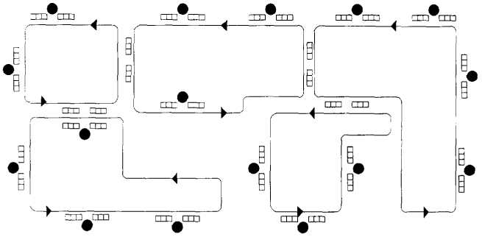
Track layout
infrastructure
location of pick-up and drop-off stations
buffer sizes
  congestion/blocking
tandem configuration

Slide 55
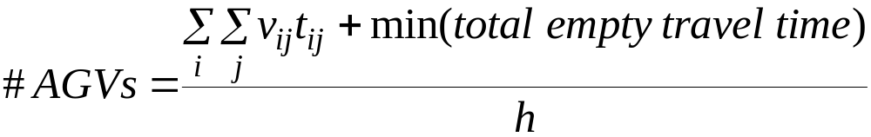
Determination of number of AGVs
6 x
4 x
LP-problem
(i.e. a classical TP)
5 x

Slide 56
Operational transportation control
Job control
(routing and scheduling of transportation tasks)
Traffic control
Traffic rules
Goal: minimize empty travel + waiting time
Single load:
Performance indicators:
- Throughput
- Throughput times

Slide 57
Operational control
production control ←→ transportation control
  flow shop
  job shop
centralized control
  all tasks are concurrently considered
or decentralized control
  FEFS: AGV looks for work (suited for tandem configuration)
think-ahead
  combine tasks to routes
or no think-ahead

Slide 58
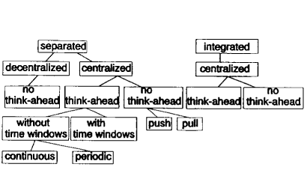
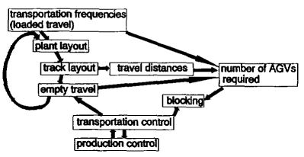
Relations between the issues

Slide 59
Combination 1
Separated/no think-ahead
centralized control
on-line priority rules:
  transportation task assignment
  tasks wait, or
  idle vehicle assignment
  idle vehicles wait
  Ad 1: push/pull (JIT), e.g. FCFS, MOQRS
  Push → sometimes “shop locking”
  Ad 2: NV, LIV

Slide 60
Combination 3
Separated/think-ahead (1)
Centralized control
a. without time windows
  Only routing
  Minimize empty travel time by simulated annealing:
  2 options:
    determine optimal route each time a new task arrives
    problem: a task may stay at the end of the route
    Periodic control
    time horizon (length?)

Slide 61
Combination 3
Separated/think-ahead (2)
Centralized control
b. with time horizons
  Simulated annealing
machine 1
loaded trip
machine 2
empty trip
machine 3
machine 1
machine 2
loaded trip
empty trip
machine 3
machine 1
loaded trip
machine 2
empty trip
machine 3

Slide 62
Combination 4
Integrated/think-ahead
AGV’s ~ parallel machines
empty travel time ~ change-over time
transportation time ~ machine time
Shop-floor scheduling

Slide 63
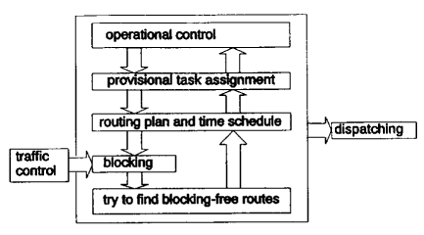
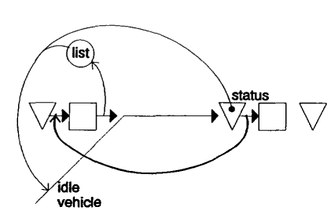
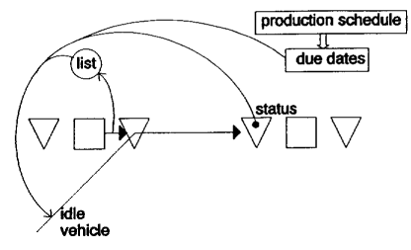
Basic concept

Slide 64
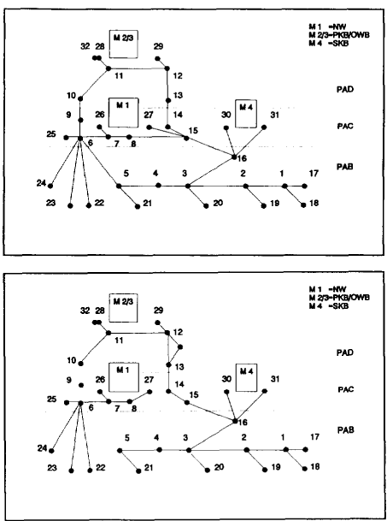
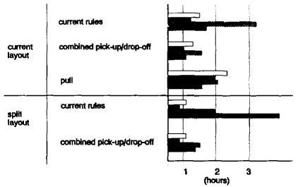
Case study

